Slide 1

HACKATHON PITCH DECK
CivicFix
Smart Urban Grievance & Duplicate Resolution Engine

Slide 2

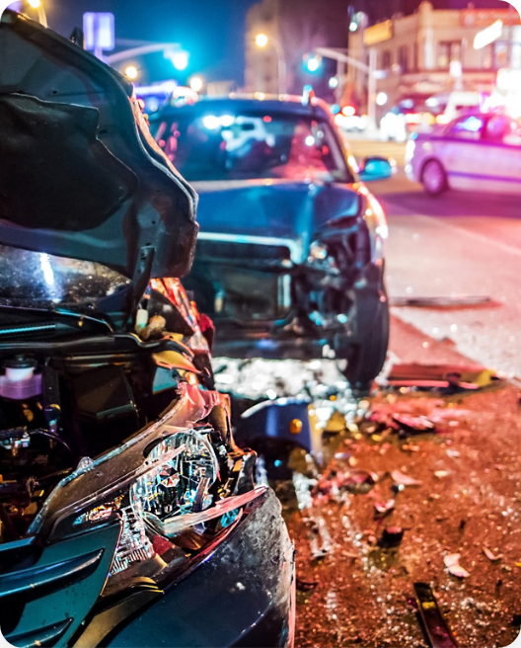
THE PROBLEM
The redundancy trap.
40 Calls, 1 Pothole.
Massive citizen overlap delays triage.
Disjointed Dispatch.
Multiple trucks sent to identical locations.
SLA Backlogs.
True emergencies buried by noise.

Slide 3



THE SOLUTION
AI-powered redressal.
Citizen Portal
AI Edge Node
ICCC Triage
One-click photo upload.
Haversine NLP deduplication.
Consolidated smart dashboard.

Slide 4
SYSTEM ARCHITECTURE
3-Tier deduplication pipeline.
1
Spatial Proximity Check
30-meter radius calculation locks nearby reports.
2
Semantic NLP Matching
Cross-lingual text embeddings match descriptions.
3
Master Ticket Synthesis
Corroborating photos merged into root dossier.

Slide 5
Engine Efficiency Benchmarks
42%
380ms
₹14L
Duplicate reduction.
AI inference speed.
Fleet fuel savings.

Slide 6

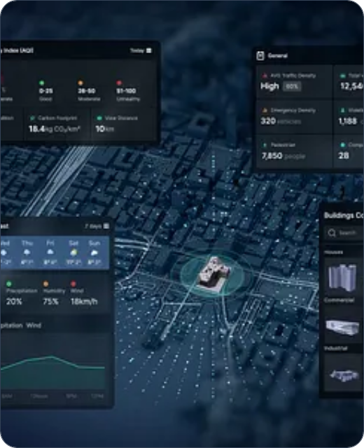
COMMAND & CONTROL
MoHUA Live Analytics.
Zonal Heatmaps: Real-time issue clustering.
SLA Tracking: 94.2% on-time resolution rate.
Officer Routing: GPS-verified field deployment.

Slide 7
The CivicFix Advantage
Traditional Flow
CivicFix Flow
Manual sorting delays.
Automated cluster synthesis.
Wasted inspection fuel.
Single efficient dispatch.
Frustrated citizens.
Mandatory 48-Hour SLA.

Slide 8
Ready to scale.
A 90-day deployment roadmap designed for Tier 1 to Tier 3 Indian municipalities.
THANK YOU

Slide 9


Image Sources
https://pennstatehealthnews.org/wp-content/uploads/2018/05/EmergencySituationNR.jpg
Source: pennstatehealthnews.org
https://cdn.dribbble.com/userupload/44660161/file/still-d19bffb3f1e850b3799c612f2d9463a7.png?format=webp&resize=400x300&vertical=center
Source: dribbble.com

